Slide 1
Replenishment
Algorithms

Slide 2
Replenishment Methods not based on Forecasting
Constant
Min/ Max
Replenishment Methods based on Forecasting
Time-Supply Issues
Dynamic

Slide 3
Replenishment
Constant Replenishment

Slide 4
Terminologies Used – Constant
Maximum Stock – This is the stock level that must be maintained in the system.
ROQ – Recommended Order Quantity.
Constant Method
Works from a maximum stock level that must be maintained.
Generally used for very slow to slow-selling items.
Simple to use and easy to evaluate results.
Does not consider forecasts.
High maintenance of parameters is required.

Slide 5
Constant Method – Test Data
Net Available On Hand (NI): 20
Maximum Stock – 25
Review Cycle – Sundays for example
Constant Method – Result
On the day review (Sunday), the ROQ will be calculated as 5 (Maximum Stock (25) – Net Available NI (20))

Slide 6
Replenishment
Min/ Max Replenishment

Slide 7
Min/ Max Method
Works from a minimum stock level which a location must maintain and a maximum stock level that must not be exceeded.
Generally used for very slow selling to slow-selling.
Simple to use and easy to evaluate results.
High maintenance parameters is required.
Does not take forecasts into consideration.
Stock outs/ over stocks can occur especially during promotional events/ seasonal periods as the parameters must be entered manually by SKU/ DC location.
Does not take seasonality, service level, etc. into consideration.

Slide 8
Terminologies – Min/ Max
Abbreviation | Description
MINS | Minimum Stock
MAXS | Maximum Stock
PS | Presentation Stock
IP | Increment Percent
DS | Demo Stock
COLT | Current Order Lead Time
NOLT | Next Order Lead Time
RT | Review Time (days)
AVAIL(t) | Available Quantity
NI | Net Inventory
OP | Order Point
ROQ | Recommended Order Quantity

Slide 9
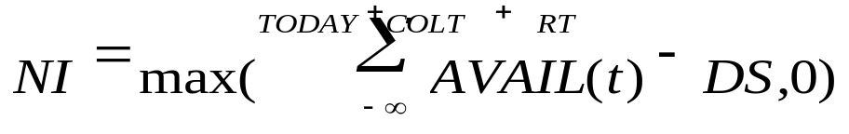
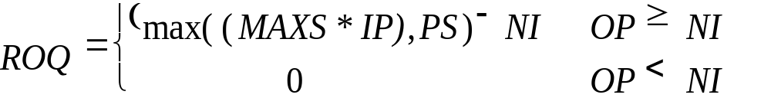
Min/ Max – Calculation

Slide 10
Test Data – For Min/ Max
Net Inventory (SOH): 9
Minimum Stock: 15
Maximum Stock: 25
Review Cycle (Sunday)
Min/ Max Method – Result
On the day review (Sunday), the ROQ will be calculated as 16 (Maximum Stock (25) – Net Inventory (9))

Slide 11
Replenishment
Time Supply Replenishment

Slide 12
Time Supply Replenishment
Used when the objective is to prevent stock outs and maintain a constant inventory.
Items for which days of supply stock is desired to be maintained.
Simple extension of Min/ Max method and adjustments to demand.
Good method to maintain inventory over a set number of days.
Minimizes shipping frequency.
Not good if the number of days is small.
Does not take Ordering Frequency (Review Time) into account.
Does not consider service level objective into account.

Slide 13
Terminologies Used – Time Supply
Abbreviation | Description
MINTS | Minimum Time Supply Days
MAXTS | Maximum Time Supply Days
TSH | Time Supply Horizon (optional)
PS | Presentation Stock
DS | Demo Stock
F(t) | Approved Forecasts
AVAIL(t) | Available Quantity* (see note)
NI | Net Inventory
OP | Order Point
ROQ | Recommended Order Quantity
ROS | Daily Rate of Sale (or Issues)

Slide 14
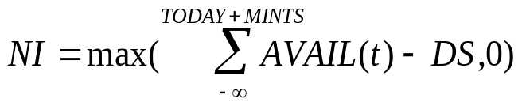
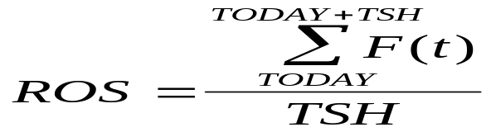

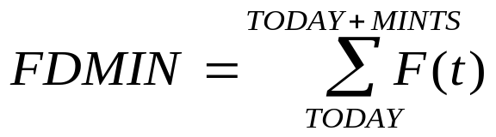
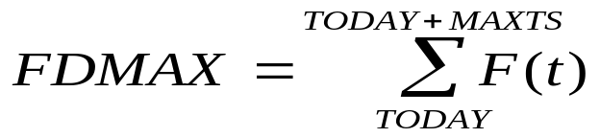

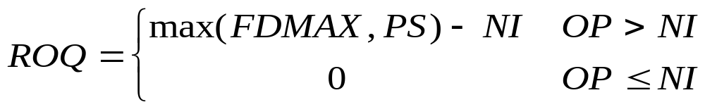
Time Supply - Calculation
If TSH is defined, then this equation applies
If TSH is not defined, then this equation applies

Slide 15
Time Supply Issues - Data
Net Available OH: 30
Expected Forecast Sales/ Days: 21
Minimum Time Supply: 5 Days
Maximum Time Supplier: 10 Days
Time Supply Horizon: 0 and 5
Review Cycle (Every week - Sunday)
Forecasts are 4, 6, 8, 10, 4, 8, 10, 12, 8, 10

Slide 16
Time Supply – Formula (Time Supply Horizon is not defined)
NI = Sum of Stock from today till the minimum time supply days (30)
FDMIN=Sum of Forecasts from today till minimum time supply days (32).
FDMAX=Sum of Forecasts from today till maximum time supply days (80).
ROQ=FDMAX-NI, if FDMIN>NI (50)
ROQ=0, if FDMIN<=0

Slide 17
Time Supply – Formula (Time Supply Horizon is defined)
NI = Sum of Stock from today till the minimum time supply days (30)
ROS=Sum of forecasts from today till TSH/TSH (6.4)
FDMIN=ROS * Minimum Time Supply Days (32).
FDMAX=ROS * Maximum Time Supply Says (64).
ROQ=FDMAX-NI, if FDMIN>NI (34)
ROQ=0, if FDMIN<=0

Slide 18
Replenishment
Dynamic Replenishment

Slide 19
Dynamic Algorithm
Used for items where the service level is high and high SKU values.
Allows more changing attributes.
Minimizes adjustments of replenishment parameters for trend and seasonality.
More Reliable method to achieve a high inventory turn (demand-based, not planning based).
Most complex and powerful algorithm.
Required generation and maintenance of accurate forecasts.

Slide 20
Terminologies - Dynamic Replenishment
Abbreviation | Description
COLT | Current Order Lead Time (days)
NOLT | Next Order Lead Time (days)
RT | Review Time (days)
ISD | Inventory Selling Days (days)
SL | Service Level (%)
LSF | Lost Sales Factor (% of lost sales recurring as demand)
F(t) | Approved Forecasts
S(t) | Standard Deviation of Cumulative Forecast at time t
AVAIL(t) | Available Quantity
DS | Demo Stock
PS | Presentation Stock
NI | Net Inventory
OP | Order Point
OUTP | Order Up To Point
ROQ | Recommended Order Quantity
W | Expected Number of Units Short
Z | Number of Standard Deviations of Safety Stock

Slide 21
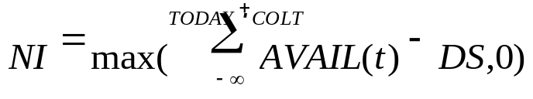
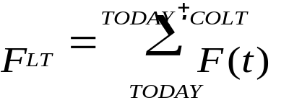
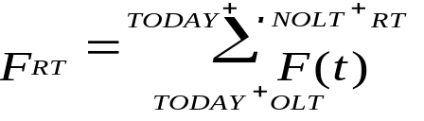
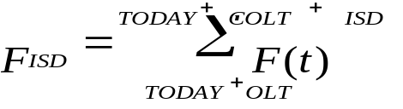
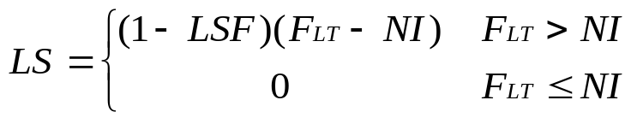
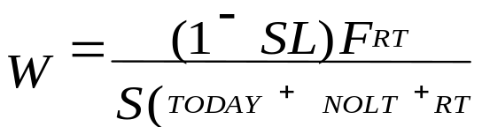


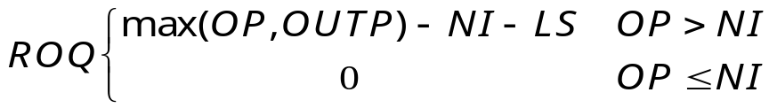
Dynamic Replenishment - Calculation
Safety Stock Calculation

Slide 22
Dynamic Replenishment - Example
Review Day M Th
Delivery Day W M
Review Time 3 4
Current Lead Time (COLT) 2 (2+2) = 4
Next Order Lead Time (NOLT) 4 2
Inventory Selling Days (ISD) 7 7

Slide 23
Dynamic Replenishment - Example
NOLT RT
COLT ISD Order Order
DD Point Up To
Point
NOLT RT
COLT DD Order ISD Order
Point Up To
Point
NOLT RT
COLT DD
ISD Order
Order
Point Up To
Point

Slide 24
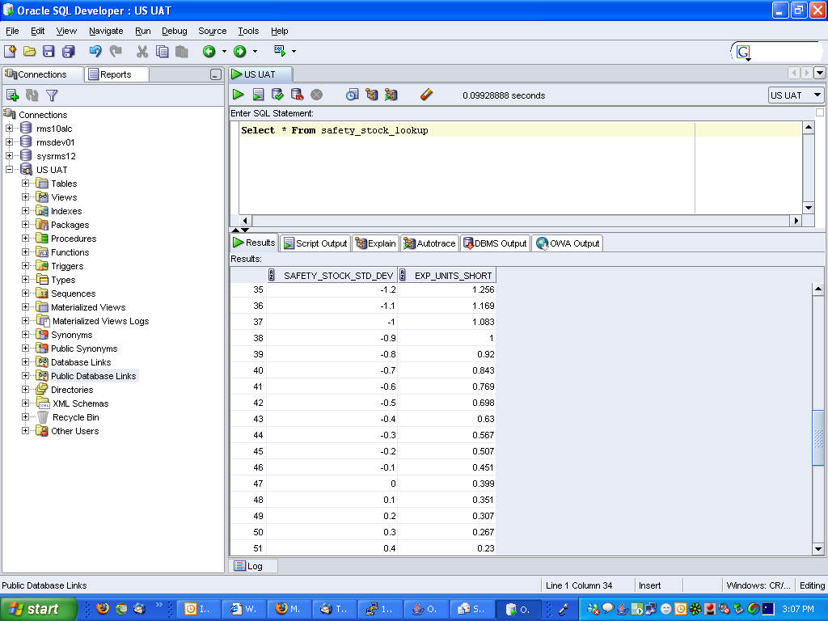
Safety Stock Lookup

